Slide 1
Heap
A heap is a data structure that stores a collection of objects (with keys), and has the following properties:
Complete Binary tree
Heap Order
It is implemented as an array where each node in the tree corresponds to an element of the array.

Slide 2
Binary Heap
The binary heap data structures is an array that can be viewed as a complete binary tree. Each node of the binary tree corresponds to an element of the array. The array is completely filled on all levels except possibly lowest.
19
12
16
1
4
7
19
12
16
1
4
7
Array A

Slide 3
Heap
The root of the tree A[1] and given index i of a node, the indices of its parent, left child and right child can be computed
PARENT (i) return floor(i/2) LEFT (i) return 2i RIGHT (i) return 2i + 1

Slide 4
Heap order property
For every node v, other than the root, the key stored in v is greater or equal (smaller or equal for max heap) than the key stored in the parent of v.
In this case the maximum value is stored in the root

Slide 5
Definition
Max Heap
Store data in ascending order
Has property of
A[Parent(i)] ≥ A[i]
Min Heap
Store data in descending order
Has property of
A[Parent(i)] ≤ A[i]

Slide 6
Max Heap Example
19
12
16
1
4
7
19
12
16
1
4
7
Array A

Slide 7
Min heap example
1
4
16
7
12
19
1
4
16
7
12
19
Array A

Slide 8
Applications of Heaps
1) Heap Sort: Heap Sort uses Binary Heap to sort an array in O(nLogn) time.
2) Priority Queue: Priority queues can be efficiently implemented using Binary Heap because it supports insert(), delete() and extractmax() operations in O(logn) time. Binomoial Heap and Fibonacci Heap are variations of Binary Heap. These variations perform union also efficiently.
3) Graph Algorithms: The priority queues are especially used in Graph Algorithms like Dijkstra’s Shortest Path and Prim’s Minimum Spanning Tree.
4) Many problems can be efficiently solved using Heaps like a) K’th Largest Element in an array. b) Sort an almost sorted array/ c) Merge K Sorted Arrays.
d) Huffman coding

Slide 9
Insertion
Algorithm
Add the new element to the next available position at the lowest level
Restore the max-heap property if violated
General strategy is percolate up (or bubble up): if the parent of the element is smaller than the element, then interchange the parent and child.
OR
Restore the min-heap property if violated
General strategy is percolate up (or bubble up): if the parent of the element is larger than the element, then interchange the parent and child.

Slide 10
19
19
12
16
12
16
4
7
1
4
7
17
1
Insert 17
19
12
17
swap
1
4
7
16
Percolate up to maintain the heap property

Slide 11
Heap Sort
A sorting algorithm that works by first organizing the data to be sorted into a special type of binary tree called a heap
Procedures on Heap:
1. Heapify
2. Build Heap
3. Heap Sort

Slide 12
Heapify
Heapify picks the largest child key and compare it to the parent key. If parent key is larger than heapify quits, otherwise it swaps the parent key with the largest child key. So that the parent is now becomes larger than its children.
Heapify(A, i)
{ l ← left(i) r ← right(i) if l <= heapsize[A] and A[l] > A[i] then largest ←l else largest ← i if r <= heapsize[A] and A[r] > A[largest] then largest ← r if largest != i then swap A[i] ←→ A[largest] Heapify(A, largest) }

Slide 13
Build Heap
We can use the procedure 'Heapify' in a bottom-up fashion to convert an array A[1 . . n] into a heap. Since the elements in the subarray A[n/2 +1 . . n] are all leaves, the procedure BUILD_HEAP goes through the remaining nodes of the tree and runs 'Heapify' on each one. The bottom-up order of processing node guarantees that the subtree rooted at children are heap before 'Heapify' is run at their parent.
Buildheap(A)
{ heapsize[A] ←length[A] for i ←|length[A]/2 //down to 1 do Heapify(A, i) }

Slide 14
Heap Sort Algorithm
The heap sort algorithm starts by using procedure BUILD-HEAP to build a heap on the input array A[1 . . n]. Since the maximum element of the array stored at the root A[1], it can be put into its correct final position by exchanging it with A[n] (the last element in A). If we now discard node n from the heap than the remaining elements can be made into heap. Note that the new element at the root may violate the heap property. All that is needed to restore the heap property.
Heapsort(A)
{ Buildheap(A) for i ← length[A] //down to 2 do swap A[1] ←→ A[i] heapsize[A] ← heapsize[A] - 1 Heapify(A, 1) }

Slide 15
Example: Perform Heap Sort
16
4
7
1
12
19
Initial Step:
Build the Heap
Picture the array as a complete binary tree:
16
4
7
1
12
19

Slide 16
16
16
4
7
4
19
swap
12
19
1
12
7
1
16
19
swap
12
19
12
16
swap
4
7
1
4
7
1

Slide 17
Heap Sort
The heapsort algorithm consists of two phases: - build a heap from an arbitrary array - use the heap to sort the data
To sort the elements in the decreasing order, use a min heap
To sort the elements in the increasing order, use a max heap
19
12
16
1
4
7

Slide 18
Pass 1
Take out biggest
19
12
16
Move the last element
to the root
1
4
7
Sorted:
Array A
12
16
1
4
7
19

Slide 19
Pass 1
7
swap
HEAPIFY()
12
16
1
4
Sorted:
Array A
7
12
16
1
4
19

Slide 20
Pass 1
16
12
7
1
4
Sorted:
Array A
16
12
7
1
4
19

Slide 21
Pass 2
Take out biggest
16
Move the last element
to the root
12
7
1
4
Sorted:
Array A
12
7
1
4
16
19

Slide 22
Pass 2
4
12
7
1
Sorted:
Array A
4
12
7
1
16
19

Slide 23
Pass 2
swap
4
HEAPIFY()
12
7
1
Sorted:
Array A
4
12
7
1
16
19

Slide 24
Pass 2
12
4
7
1
Sorted:
Array A
12
4
7
1
16
19

Slide 25
Pass 3
Take out biggest
12
Move the last
element to the
root
4
7
1
Sorted:
Array A
4
7
1
12
16
19

Slide 26
Pass 3
1
swap
4
7
Sorted:
Array A
1
4
7
12
16
19

Slide 27
Pass 3
7
4
1
Sorted:
Array A
7
4
1
12
16
19

Slide 28
Pass 4
Take out biggest
7
Move the last
element to the
root
4
1
Sorted:
Array A
1
4
7
12
16
19

Slide 29
Pass 4
swap
1
HEAPIFY()
4
Sorted:
Array A
4
1
7
12
16
19

Slide 30
Pass 5
Take out biggest
Move the last
element to the
root
4
1
Sorted:
Array A
1
4
7
12
16
19

Slide 31
Pass 6
Take out biggest
1
Sorted:
Array A
1
4
7
12
16
19

Slide 32
Sorted:
1
4
7
12
16
19

Slide 33
Time Analysis
Build Heap Algorithm will run in O(n) time
There are n-1 calls to Heapify each call requires O(log n) time
Heap sort program combine Build Heap program and Heapify, therefore it has the running time of O(n log n) time
Total time complexity: O(n log n)

Slide 34
Examples
Perform Heap sort on 15, 19, 10, 7, 17, 16.
What is array representation of tree after building the heap?
What will be the preorder traversal of tree after pass 2 ?
Complete the sort and write the sorted array.
Sort the list 2, 9, 7, 6, 5, 8 by heapsort.

Slide 35
1 Which of the following sequences of array elements forms a heap?
A. {23, 17, 14, 6, 13, 10, 1, 12, 7, 5}
B. {23, 17, 14, 6, 13, 10, 1, 5, 7, 12}
C. {23, 17, 14, 7, 13, 10, 1, 5, 6, 12}
D. {23, 17, 14, 7, 13, 10, 1, 12, 5, 7}

Slide 36
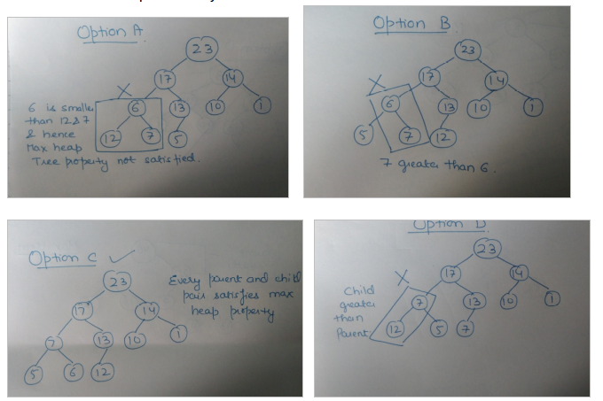

Slide 37
Huffman Coding

Slide 38
Introduction
Huffman coding is a lossless data compression algorithm.
The idea is to assign variable-length codes to input characters, lengths of the assigned codes are based on the frequencies of corresponding characters.
The most frequent character gets the smallest code and the least frequent character gets the largest code.
It’s a Bottom up approach.

Slide 39
Steps to build Huffman Tree
Input is an array of unique characters along with their frequency of occurrences and output is Huffman Tree.
1. Create a leaf node for each unique character and build a min heap of all leaf nodes (Min Heap is used as a priority queue. The value of frequency field is used to compare two nodes in min heap. Initially, the least frequent character is at root)
2. Extract two nodes with the minimum frequency from the min heap.
3. Create a new internal node with a frequency equal to the sum of the two nodes frequencies. Make the first extracted node as its left child and the other extracted node as its right child. Add this node to the min heap.
4. Repeat steps#2 and #3 until the heap contains only one node. The remaining node is the root node and the tree is complete.

Slide 40
Example
Symbol Count
A 15
B 7
C 6
D 6
E 5

Slide 41
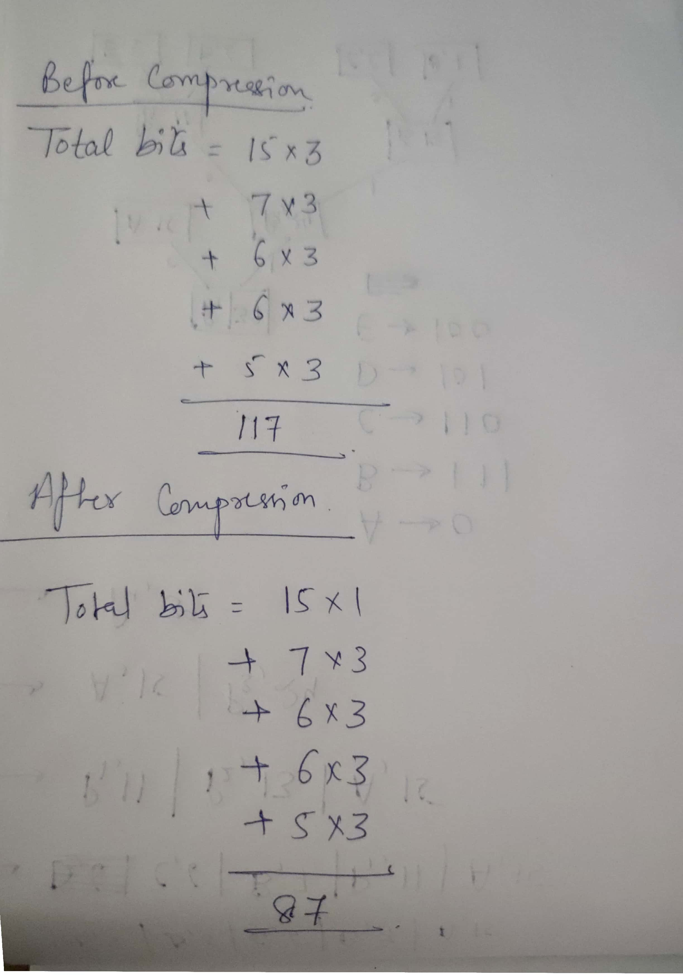

Slide 42
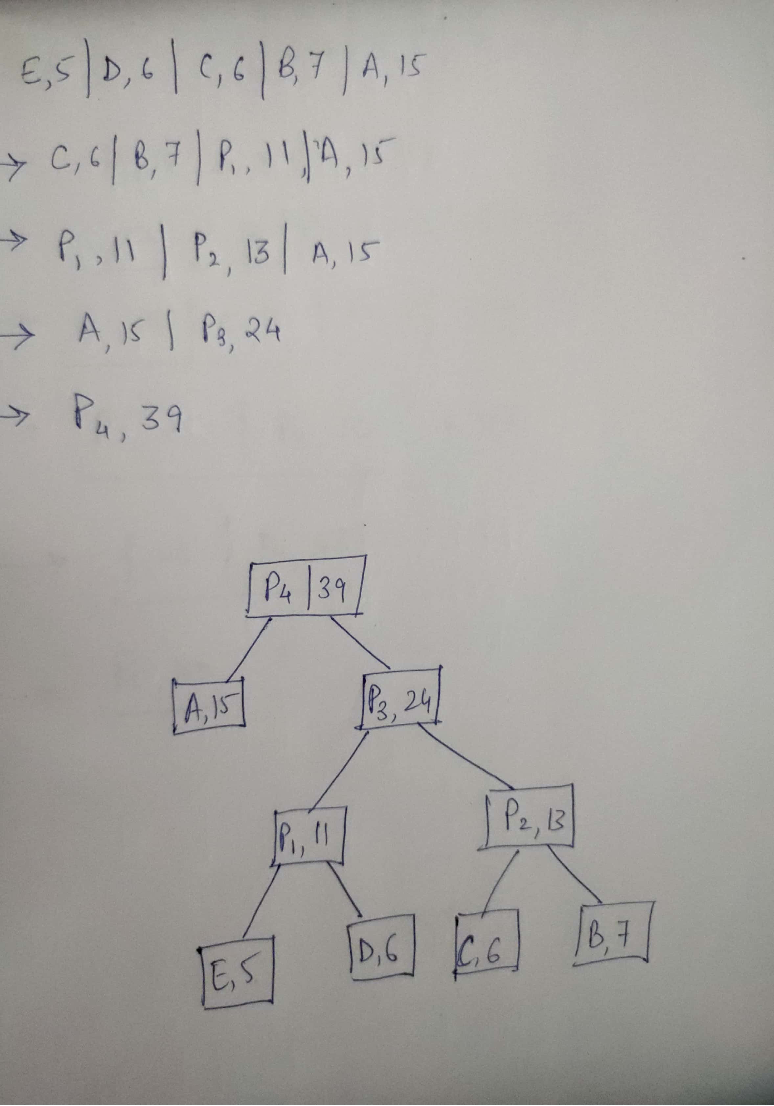

Slide 43
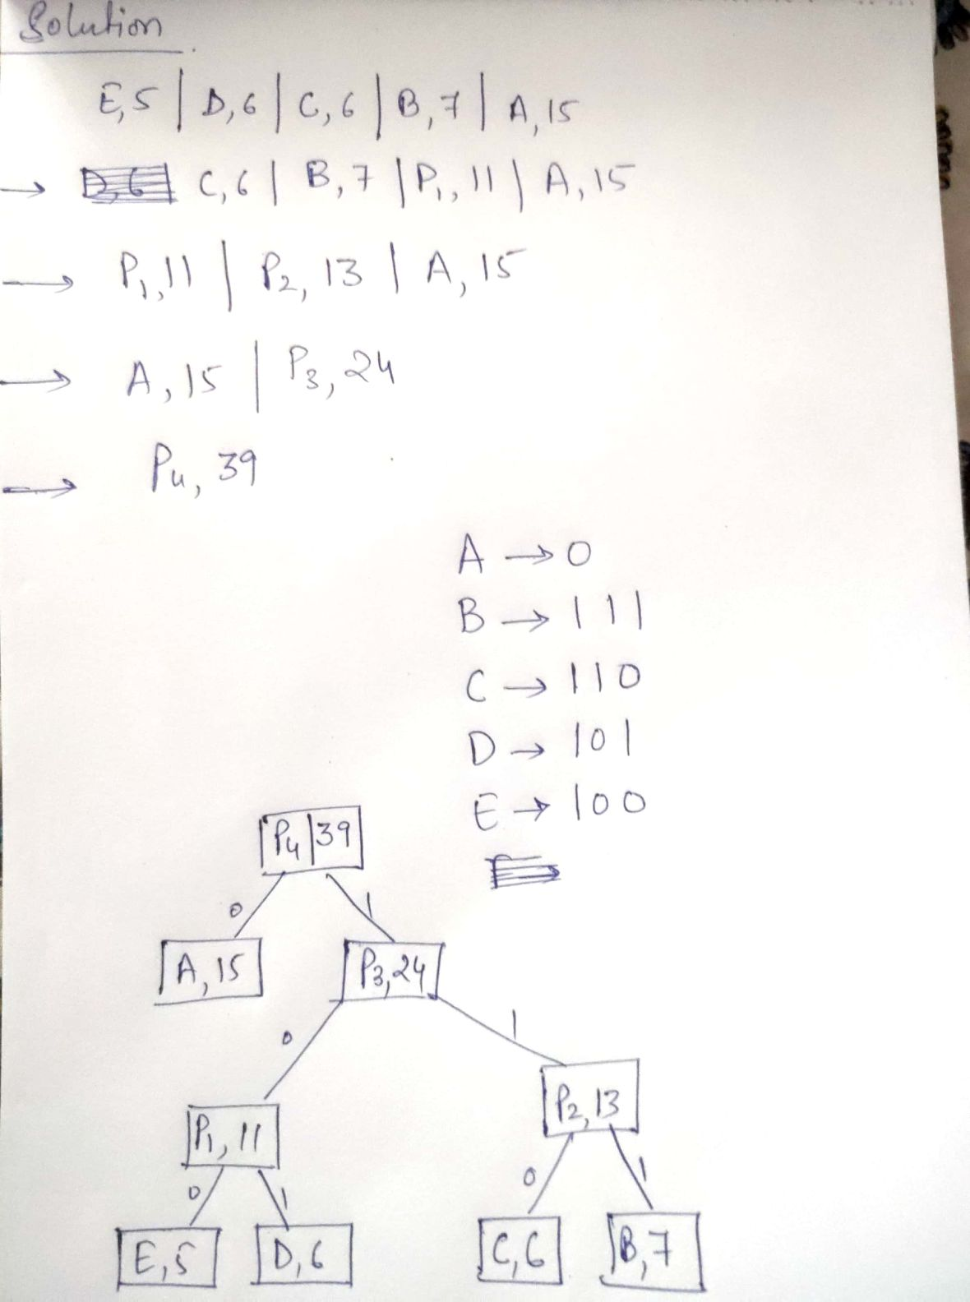

Slide 44
Example
Character Frequency
a 5
b 9
c 12
d 13
e 16
f 45
Perform Huffman Coding for the given characters (with frequencies). Find the total number of bits after compression.

Slide 45
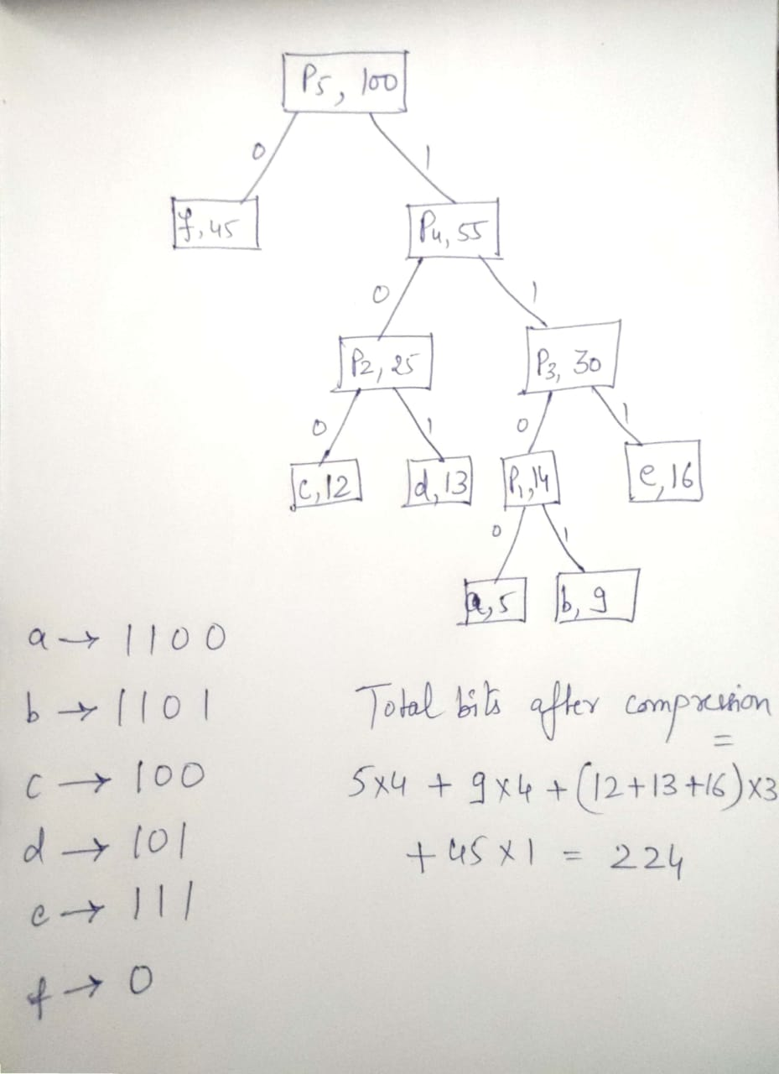

Slide 46
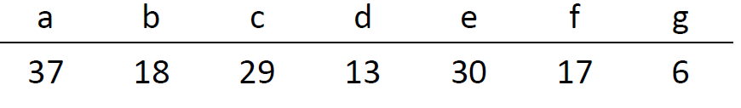
Assignment : Perform Huffman Coding for the given characters (with frequencies). Find the total number of bits after compression.

Slide 47
Ques. How many bits may be required for encoding the message ‘mississippi’?

Slide 48
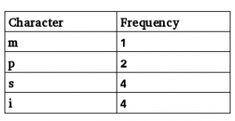
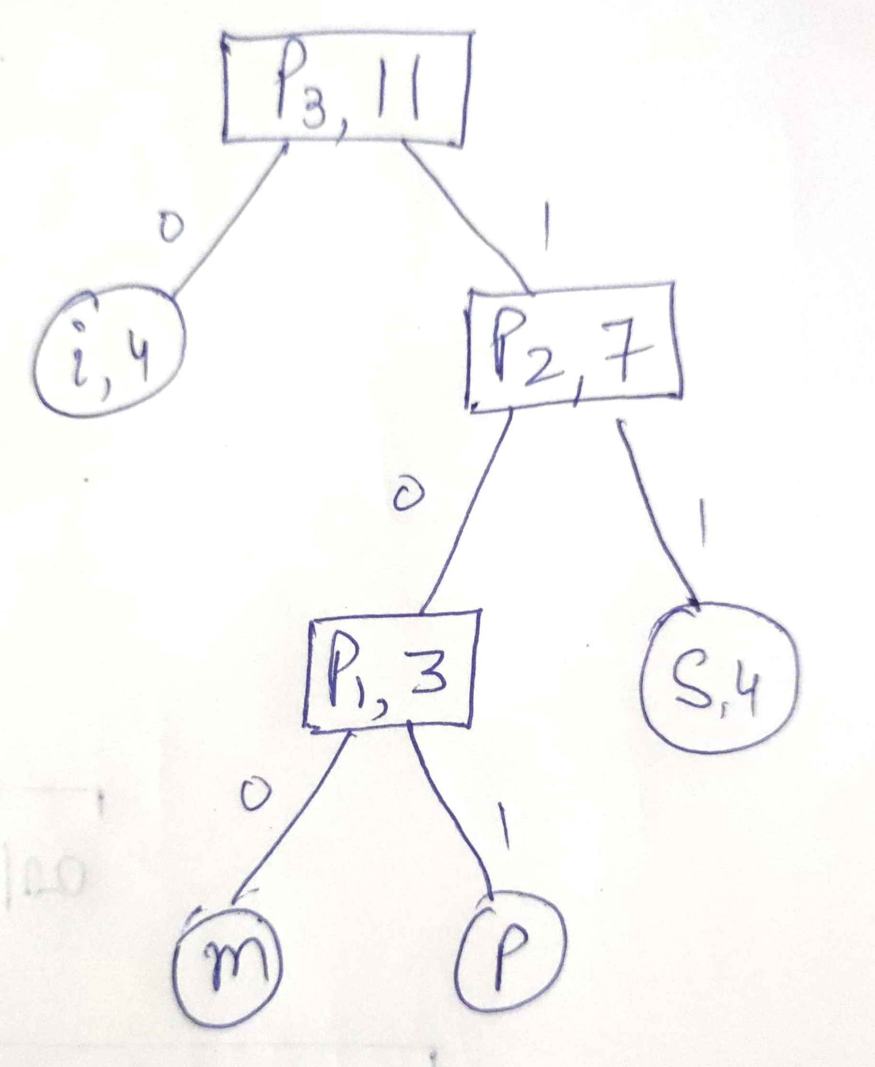
Solution: Following is the frequency table of characters in ‘mississippi’ in non-decreasing order of frequency:

Slide 49
Total number of bits
= freq(m) * codelength(m) + freq(p) * code_length(p) + freq(s) * code_length(s) + freq(i) * code length(i)
= 1*3 + 2*3 + 4*2 + 4*1 = 21
Also, average bits per character can be found as:
Total number of bits required / total number of characters = 21/11 = 1.909

